Slide 1
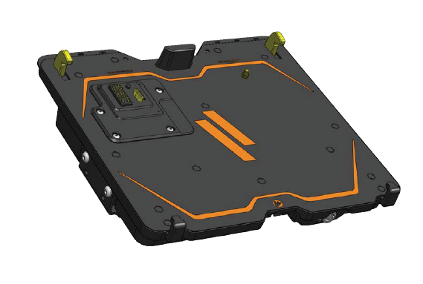
Owner’s Manual
Havis Docking Station
For GETAC V110 Convertible Notebook
DS-GTC-300 Series
DS-GTC-301
DS-GTC-301-3
DS-GTC-302
DS-GTC-302-3
DS-GTC-303
DS-GTC-305
1
DS-GTC-300-SERIES_OMN_12-17

Slide 2



Before Beginning (original instructions)
Havis is pleased to provide this Owner’s Manual to aid in the proper installation and use of the DS-GTC-300 Series Docking Station for Getac V110 Fully Rugged Convertible Notebooks
For questions regarding the set-up of your DS-GTC-300 Series Docking Station, please contact Havis at 1-800-524-9900 or visit www.havis.com for additional product support and information.
This Owner’s Manual applies to the following Part Numbers:
DS-GTC-301
DS-GTC-301-3
DS-GTC-302
DS-GTC-302-3
DS-GTC-303
DS-GTC-305
NEVER STOW OR MOUNT THE DOCKING STATION DIRECTLY IN A VEHICLE AIRBAG DEPLOYMENT ZONE.
DO NOT USE THE COMPUTER WHILE DRIVING.
READ ALL INSTRUCTIONS THOROUGHLY BEFORE BEGINNING INSTALLATION.
DOCKING OR UNDOCKING YOUR COMPUTER WHILE IN ON, STANDBY, HIBERNATION, OR SLEEP MODE CAN CAUSE SOME DEVICES TO NOT INITIALIZE PROPERLY. IF THIS OCCURS,PLEASE TURN OFF YOUR COMPUTER AND RESTART IT WHILE IT IS DOCKED.
FOR THE DS-GTC-301, DS-GTC-301-3, DS-GTC-302, DS-GTC-302-3, & DS-GTC-305 DOCKING STATIONS:
DO NOT CONNECT DIRECTLY TO VEHICLE VOLTAGE SOURCE: This product requires a certified, automotive grade, Getac approved 95W power source rated for a continuous, regulated 19VDC output
(Havis Part Number LPS-116 or equivalent). Failure to comply with this requirement will cause product damage that is NOT repairable and is NOT covered under warranty.
FOR THE DS-GTC-303 DOCKING STATION:
DO NOT CONNECT DIRECTLY TO VEHICLE VOLTAGE SOURCE: The Getac V110 notebook requires a certified, Getac approved power source rated for a continuous, regulated 19VDC output. Failure to comply with this requirement will cause product damage that is NOT repairable and is NOT covered under warranty.
FOR DOCKING STATION MODELS EQUIPPED WITH A BUNDLED POWER SUPPLY
(DS-GTC-302, DS-GTC-302-3) REFER TO THE SUPPLIED LIND POWER SUPPLY REFERENCE GUIDE.
WHEN NOTEBOOK IS DOCKED, THE BATTERY WILL ONLY CHARGE BETWEEN 0°C to 50°C (32°F to 122°F).
PLEASE REFER TO GETAC V110 OWNER’S MANUAL FOR MORE INFORMATION.
2

Slide 3
Table of Contents
Specifications
Parts Included
Port Replication Capability
Antenna Identification
Installation
Cable Management
Operation - Docking
Operation - Undocking
3
4
5
5
6
7
8
9
Precautions
Do not place metal objects or containers of liquid on top of the Docking Station
If a malfunction occurs, immediately unplug the Power Supply and remove the laptop
Use only the specified Power Supply (Part # LPS-116) with this Docking Station
Do not store the Docking Station where water, moisture, steam, dust, etc. are present
Do not connect cables into ports other than what they are specified for
Do not leave the Docking Station in a high temperature environment (greater than 85°C, 185°F) for a long period of time
Specifications
Power Supply Input | 19.0V DC-In
Dimensions | 2.8” ( 7.1 cm) H x 11.8” ( 29.9 cm ) W x 11.0” ( 27.9 cm ) D
Weight | 5.1 lbs ( 2.3 kg )
Operating Environment | -20° C to 60° C ( -4° F to 140°F )
Storage Environment | -40° C to 71° C ( -40° F to 160° F )
EC DECLARATION OF CONFORMITY in accordance with EN 50498
Manufacturers Name: Havis, Inc.
Manufacturers Address: 47099 File Mile Road, Plymouth Twp, MI 48170 USA
Declares under our sole responsibility that the product:
Product name : Havis Docking Station For Getac V110 Full Rugged Convertible Notebook
Model : DS-GTC-30X, where ‘X’ may be any alphanumeric character and which describes product options.
May be followed by any alphanumeric characters which describe product options.
Product Options : This declaration covers all options of the above product which bear the CE Marking.
Is in conformity with the following standards or other normative documents:
Automotive EMC Directive: EN 50498:2010, Electromagnetic compatibility (EMC) -
2004/108/EC : Product family standard for aftermarket electronic equipment in vehicles
Directive 2011/65/EU : Restriction of the use of certain hazardous substances (RoHS)
Supplementary Information:
The product herewith complies with the requirements of the Automotive EMC Directive 2004/108/EC, Annex I, 6.5, 6.6, 6.8, and 6.9. This product requires the use of a recommended e-Marked automotive power supply when used within vehicles.
Plymouthtwp, MI, USA July 30, 2014 Bruce Jonik, Director of Engineering , Havis, Inc.
FCC 47CFR, Part 15 compliance: This is an FCC Class B device. Any changes or modifications to the model DS-GTC-30X not expressly approved by Havis, Inc. could void the user's authority to operate this equipment.
3

Slide 4
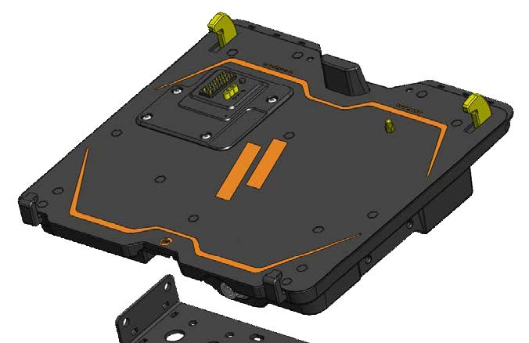

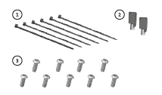
Parts Included
Docking Station
Rear Hooks (x2)
Strain Relief Points
Rear Fence
Docking Connector
Locater Pin
Latching Handle
Front Hooks
Barrel Lock
Stylus Holder
Mounting Bracket
Hardware Kit
This Hardware Kit includes:
Zip Ties (6)
Keys (2)
1/4” – 20 x 5/8” long
Button Head Screws (9)
Tools required for installation:
5/32” Hex Drive (For attaching Mounting Bracket to Motion Device with Button Head 1/4” -20 Screws)
4

Slide 5

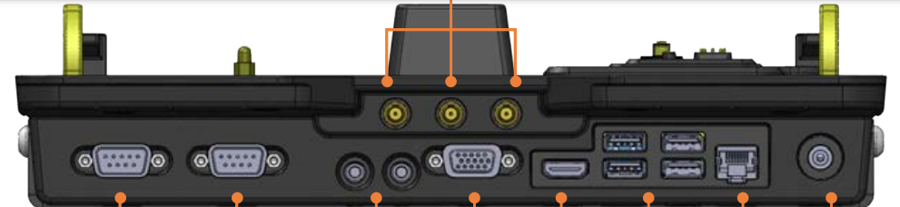







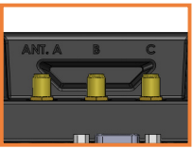
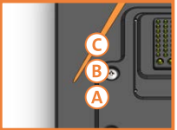
Port Replication Capability
Rearward Facing Ports
Antennas
(DS-GTC-301-3,
DS-GTC-302-3)
(optional)
Serial (X2)
Microphone/
Speaker
VGA
HDMI
USB 2.0
(x3)
Ethernet
RJ45
Power
Input
USB 3.0
(x1)
Antenna Identification (DS-GTC-301-3, DS-GTC-302-3)
A
- GPS
B
- WLAN/WIFI
C
- 4G/CELLULAR
Rearward Facing Antennas
Laptop Interface
5

Slide 6
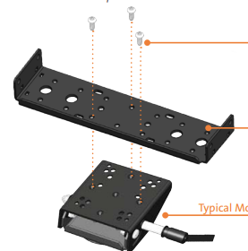
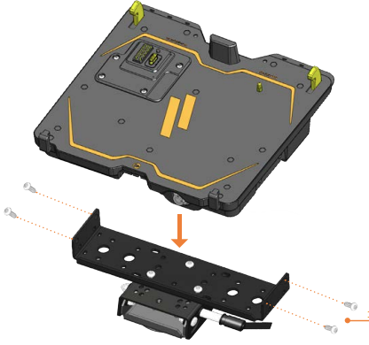
Installation
Remove the Mounting Bracket from the packaging. Install the Mounting Bracket to the Motion Device using (3) 1/4“-20 x 5/8” long screws
(Hardware Kit Item 3). Torque screws to 80 in-lbs (9.0Nm) ± 10%
NOTE: Numerous hole patterns present in Mounting Bracket will accomodate Havis Motion Devices as well as most competitors’
1/4”-20 Screws
Mounting Bracket
Typical Motion Device Example
(not included)
NOTE: We recommend applying a drop of medium strength (blue) thread locking adhesive to the threads of all fasteners.
Lower the Docking Station to the Mounting Bracket as shown and secure with (4) 1/4”-20 x 5/8” long screws (Hardware Kit Item 3). Torque screws to 80 in-lbs (9.0 Nm) ± 10%.
1/4”-20 Screws
6

Slide 7
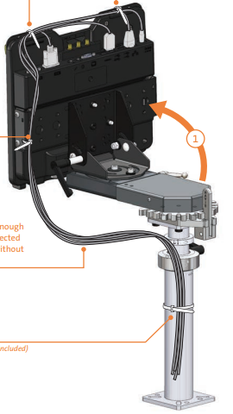
Cable Management
Orient the Docking Station in a position that is comfortable to work with.
Install all cables that are necessary for computing needs. Use Zip Ties (Hardware Kit Item 1) to strain relieve cables to the Strain Relief Points, routing all cables together to the front of the Docking Station.
Secure cable bundle to the Mounting Bracket with a supplied Zip Tie
Create a service loop with cable bundle to ensure that no tension is on the connectors and to enable intended motion.
Tie off cables onto a stationary part of the mounting system
(Mounting system not included with Docking Station)
2
Use as many zip ties as necessary to secure cables.
3
4
This loop must be large enough to allow full range of expected rotation and extension without stressing connections.
5
Collect cables to secure
to the mounting system
(Note: mounting system not included)
7

Slide 8
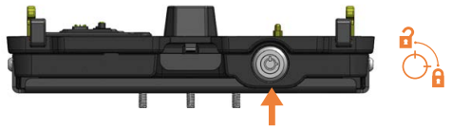
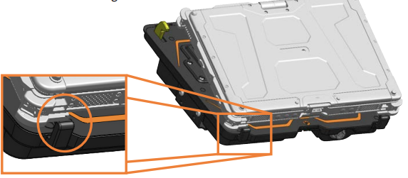
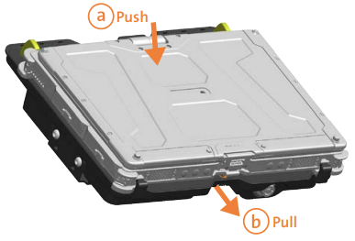
Operation - Docking
DO NOT FORCE NOTEBOOK ONTO DOCKING STATION. IF THERE IS RESISTANCE,
CHECK THE ALIGNMENT OF NOTEBOOK ON DOCKING STATION.
Ensure the Docking Station is unlatched by pushing the Lock to release
With rear of computer elevated, load front of computer into Docking Station ensuring the computer’s front hook pockets align with the front hooks of the Docking Station as shown
Lower back of computer onto Docking Station, ensuring computer properly aligns with the Locator Pin on the Docking Station. With computer seated on Docking Station, apply light downward pressure to the rear of computer and, pull the Front Latching Handle forward until latched.
a
b
8

Slide 9
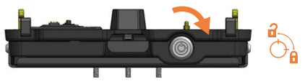
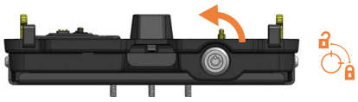
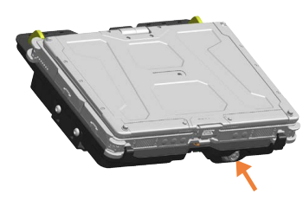
Operation – Docking (Continued)
For theft deterrence, secure computer by locking Docking Station with supplied key (Hardware Kit Item 2).
Operation - Undocking
If previously locked, unlock Docking Station using supplied key
Depress Barrel Lock to unlatch Docking Station from computer.
9

Slide 10
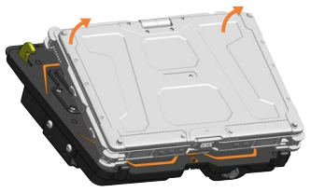
Operation – Undocking (Continued)
Once unlatched grab both sides of computer and carefully lift out of Docking Station, rear end first.
10

Slide 11


Related Products
Havis offers a wide variety of accessory products specifically for use with the DS-GTC-300 Series Docking Station. For more information or to order, please visit www.havis.com.
LPS-116
95W Power Supply
External power supply and cable for Getac Notebooks with cigarette lighter adaptor.
DS-DA-102
Night Eyes II
In-vehicle night time viewing from six long lasting, soft true, red LED lights on a flexible steel gooseneck.
DS-DA-413
Screen Stiffener
Secure your laptop screen to prevent excess wear and reduce vibration while in use.
11

