Slide 1
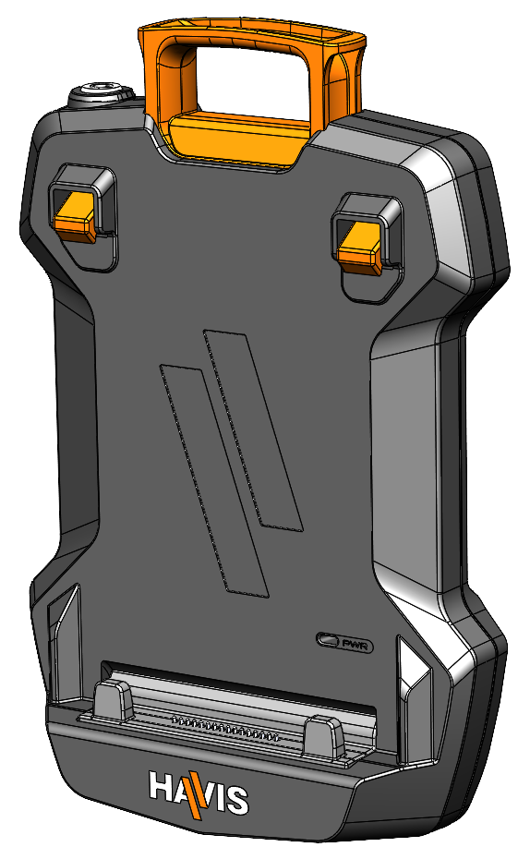
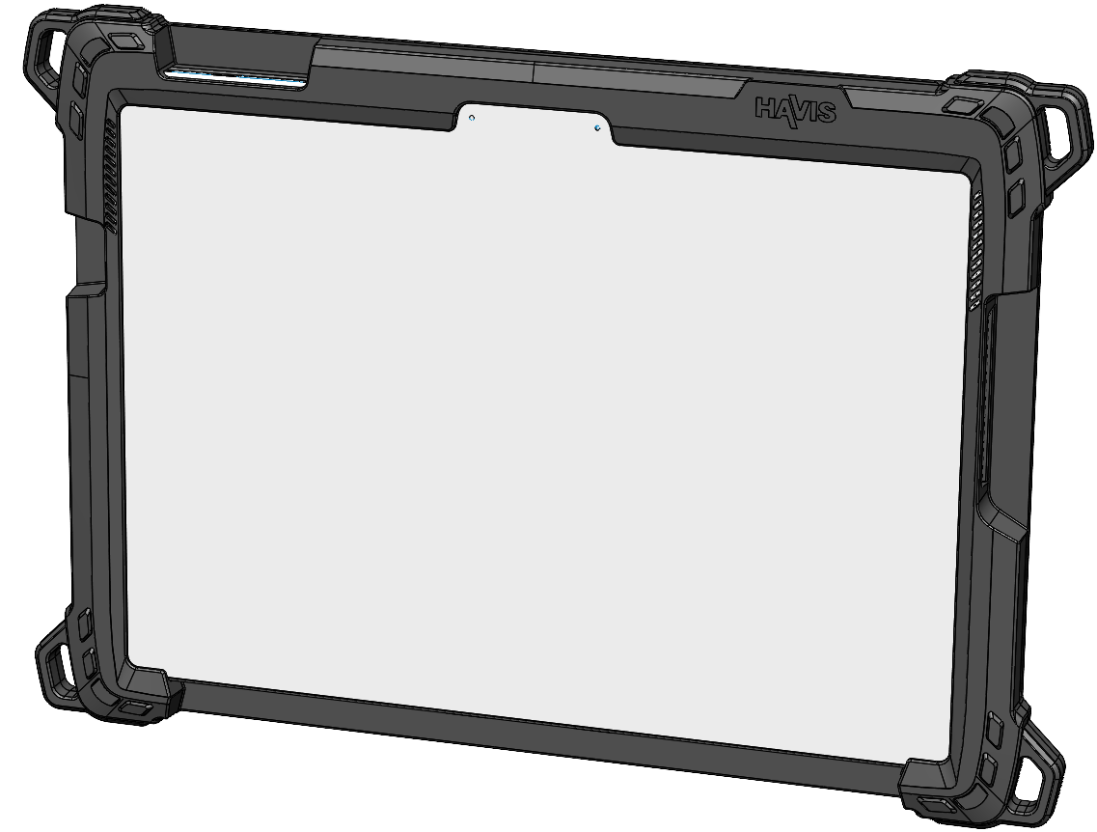
Owner’s Manual Havis Tablet Docking Stations and Tablet Cases
DS-TAB-401 Tablet Dock
TC-4XX Tablet Case
(TC-401 shown below)
^{Havis, Inc.}
^{75 Jacksonville Road}
^{Warminster, PA 18974}
DS-TAB-401^TC-4XX-SERIES_OMN_0325

Slide 2



Before Beginning
Havis is pleased to provide this Owner’s Manual to aid in the proper installation and use of the
DS-TAB-401 Series Docking Station and TC-4XX Series Tablet Case.
For questions regarding the set-up of your DS-TAB-401 Series Docking Station or TC-4XX Series Tablet Case,
please contact Havis at 1-800-524-9900 or visit www.havis.com for additional product support and information.
NEVER STOW OR MOUNT THE DOCKING STATION DIRECTLY IN A VEHICLE AIRBAG DEPLOYMENT ZONE.
DO NOT USE THE COMPUTER WHILE DRIVING.
NE JAMAIS PLACER OU MONTER LA STATION D'ACCUEIL DIRECTEMENT DANS LA ZONE DE DÉPLOIEMENT DES COUSSINS GONFLABLES D'UN VÉHICULE.
NE PAS UTILISER L'ORDINATEUR EN CONDUISANT.
READ ALL INSTRUCTIONS THOROUGHLY BEFORE BEGINNING INSTALLATION.
DO NOT STORE, INSTALL, OR OPERATE THE DOCKING STATION WHERE WATER, MOISTURE, STEAM, DUST, ETC. ARE PRESENT
FOR THE DS-TAB-400 DOCKING STATIONS: DO NOT CONNECT DIRECTLY TO VEHICLE VOLTAGE SOURCE: This product requires a certified, automotive grade, Dell/Havis approved power supply with a 24 V power output, such as the LPS-184
LISEZ ATTENTIVEMENT TOUTES LES INSTRUCTIONS AVANT DE PROCÉDER À L'INSTALLATION.
NE PAS ENTREPOSER, INSTALLER OU UTILISER LA STATION D'ACCUEIL DANS UN ENDROIT OÙ L'EAU, L'HUMIDITE, LA VAPEUR, LA POUSSIERE, ETC. SONT PRÉSENTS.
POUR LES STATIONS D'ACCUEIL DS-TAB-400. NE PAS CONNECTER DIRECTEMENT A LA SOURCE DE TENSION DU VEHICULE : Ce produit requiert un source de courant certifié, de qualité automobile et approuvé par Dell/Havis, pour une puissance de sortie de 24 V, comme le LPS-184
LITHIUM-ION BATTERIES TYPICALLY CHARGE BEST BETWEEN 5°C to 45°C (41°F to 113°F ). PLEASE REFER TO YOUR TABLET MANUFACTURER OWNER’S MANUAL FOR DETAILS.
Specifications
Power Supply Input | 24V Nominal (+/-1.0V)
Dimensions (Dock Only) | 10.08” (25.6 cm) H x 6.623” (16.3 cm) W x 2.1” (5.3 cm) D
Weight (Dock Only) | 1.24 lbs. (0.56kg)
Operating Environment (Dock) | 0° C to 35° C (32° F to 95° F)
Operating Environment (Tablet) | Please refer to your Tablet Manufacturer Owner’s Manual for operating range.
Storage Environment | -40° C to 85° C (-4° F to 185° F) Havis Product Only, please refer to your Tablet Manufacturer Owner’s Manual for storage range.
*See product page for appropriate TC-4XX product Dimensions and Weights www.havis .com*

Slide 3
Product Compatibility
Tablet | TC-4XX Tablet Case | PKG Number when paired with a DS-TAB-401 Docking Station and Vehicle Power Supply
Microsoft Surface Pro 9, 10, & 11th Edition | TC-401 | PKG-TAB4-MSFT1-DC
Apple iPad Pro 13" (M4) | TC-402 | PKG-TAB4-APP1
Apple iPad Pro 11" (M4) | TC-403 | PKG-TAB4-APP2
Apple iPad Pro 12.9" (4th - 6th Gen) and iPad Air 13" (M2) | TC-404 | PKG-TAB4-APP3
Apple iPad Air 11" (4th - 5th Gen, M2) | TC-405 | PKG-TAB4-APP6
Apple iPad Pro 10th Gen 11” | TC-406 | PKG-TAB4-APP5
Samsung Tab Active4 Pro (10") | TC-407 | PKG-TAB4-SAM1
Samsung Galaxy Tab S9+/S10+ | TC-408 | PKG-TAB4-SAM2
Apple iPad Pro 11" (2nd - 4th Gen) | TC-409 | PKG-TAB4-APP4
Specifications
Precautions
If a malfunction occurs, immediately unplug the Power Supply and remove the tablet
Use only the specified Power Cable with this Docking Station
Do not connect cables into ports other than what they are specified for
Do not leave the Docking Station in a high temperature environment (greater than 85°C, 185°F) for a long period of time
Do not dock Tablet Case if Docking Connector Pins are bent or damaged

Slide 4
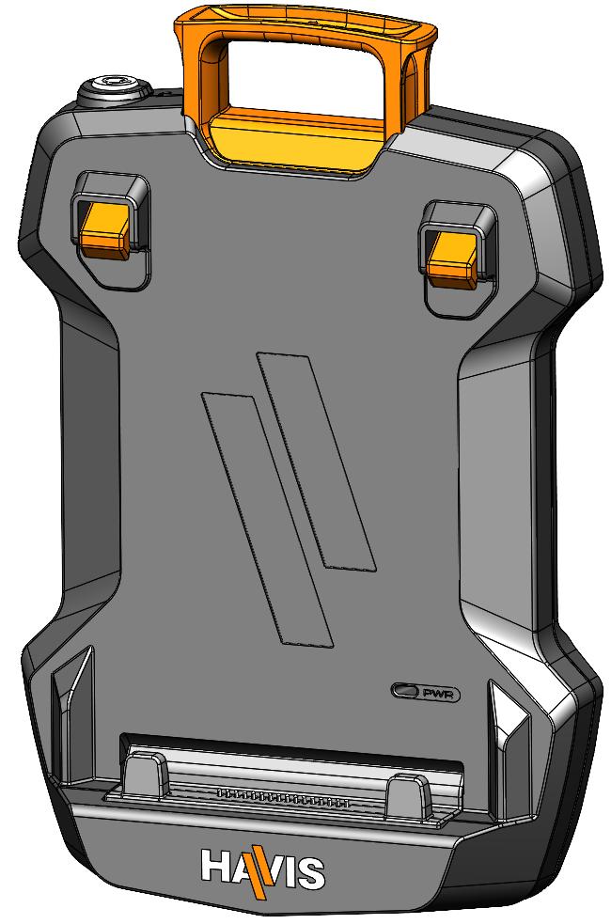
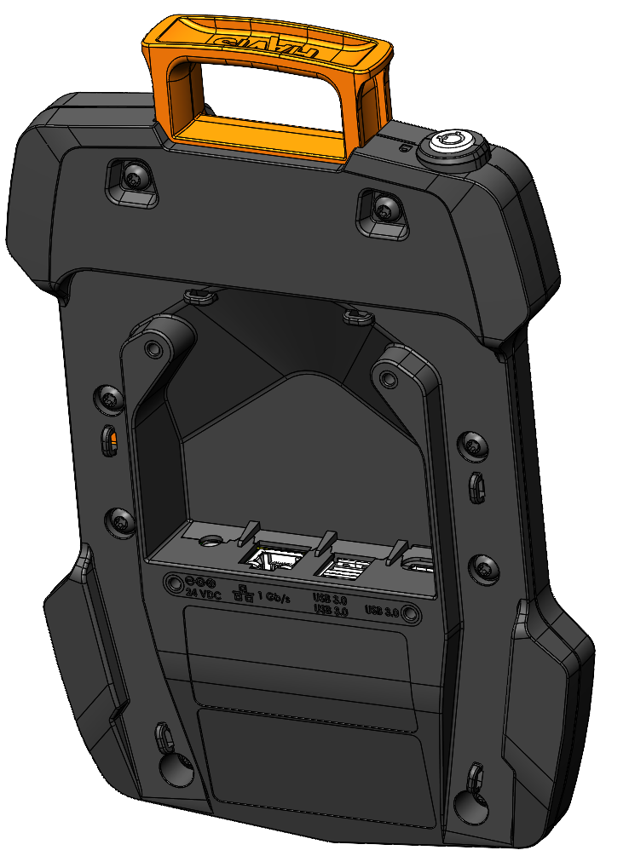
Parts Included (DS-TAB-401)
Docking Station
Release Handle
Barrel Lock
Alignment Posts
Latch Hook
LED Power Indicator
Alignment Posts
Docking Connector
Cable Routing Features (6X)
Mounting Holes (x4)
(VESA 75mm Hole Pattern)
M4 X 0.07mm THREAD
Ports

Slide 5

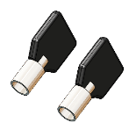
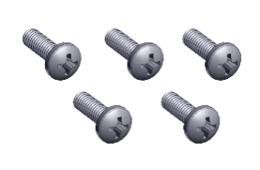


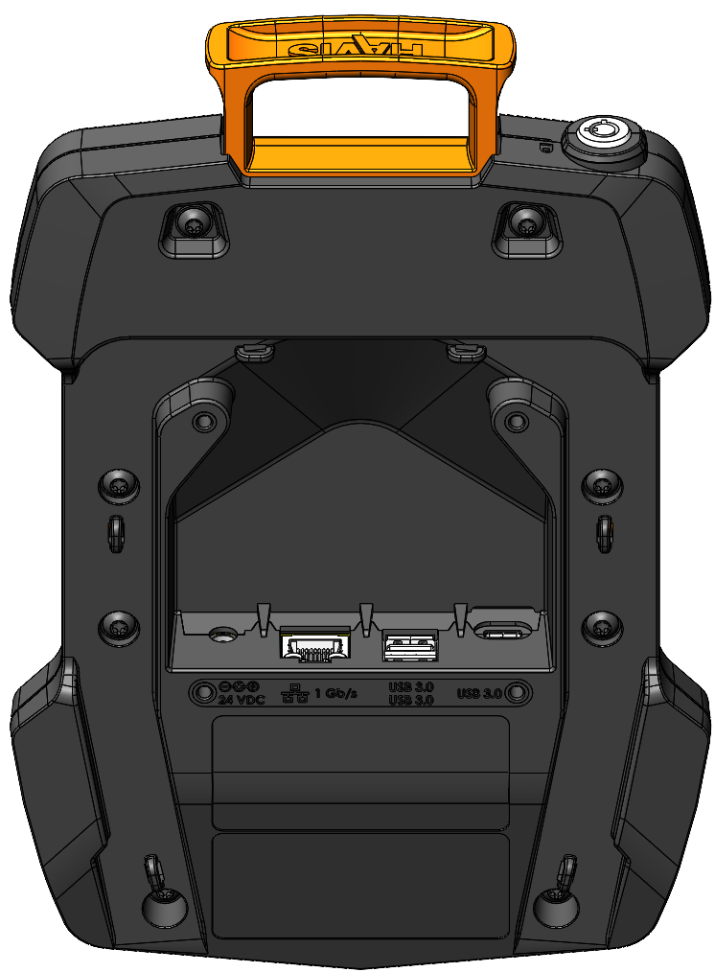


Parts Included (DS-TAB-401) (continued)
Hardware Kit (HWK-0042)
j
k
This Hardware Kit includes:
1. Zip Ties (5)
2. Keys (2)
3. M4 x 0.7 x 12mm Long Screws (5)
4. Flat Washers, M4 (5)
5. Lock Washers, M4 (5)
Tools required for installation:
• #2 Phillips
(For attaching Docking Station to VESA 75mm
hole pattern equipment with M4 x 0.7 x 12mm Screws)
l
m
n
Port Replication Capability (DS-TAB-401)
Upward Facing Ports
Gigabit Ethernet
USB3.2 Gen1 Type-A (2x)
Power Input
24.0VDC (+/-1.0V), Max Current = 4.0A
USB3.2 Gen1 Type-C (1x)

Slide 6
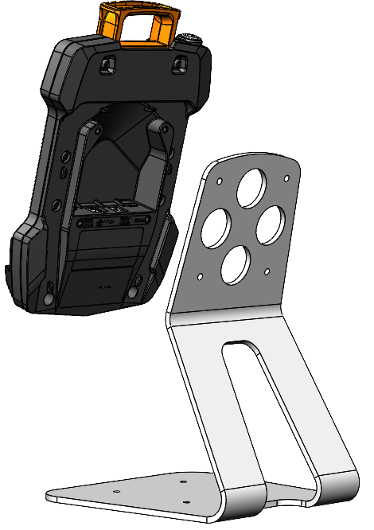


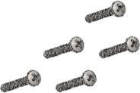
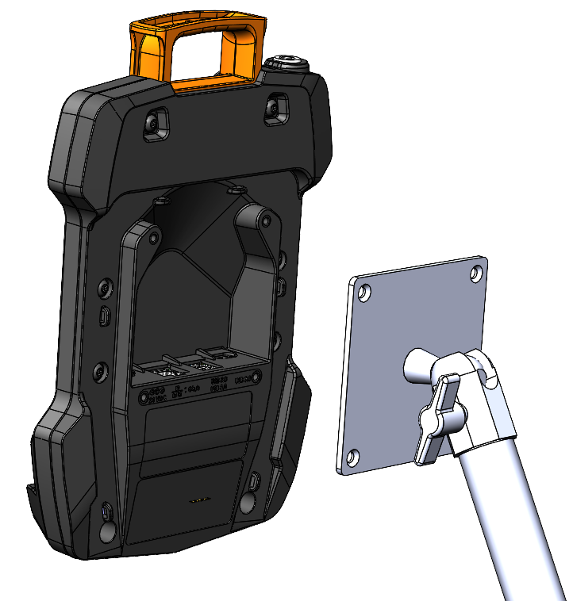
Installation (DS-TAB-401)
Align Docking Station mounting holes with the hole pattern on mounting device. Using the four (4) M4 0.7 x 12mm Pan Head Screws (Hardware Kit Item 3), four (4) Washers, M4 (Hardware Kit Item 4), and four (4) Lock Washers, M4 (Hardware Kit Item 5), secure the Docking Station to device. Torque screws to 15 in-lbs (1.7Nm) ± 10%
A) Havis Desktop Stand installation (sold separately, Part # DS-DA-218).
B) In-Vehicle mounting system installation (not included).
Washer, M4
Lock Washer, M4
M4 x 0.7 x 12mm
Pan Head Screws
Desktop Stand
(not included)
Washer, M4
Lock Washer, M4
M4 x 0.7 x 12mm
Pan Head Screws
Mounting Device
(Part ID: C-MD-402 shown, not included)

Slide 7
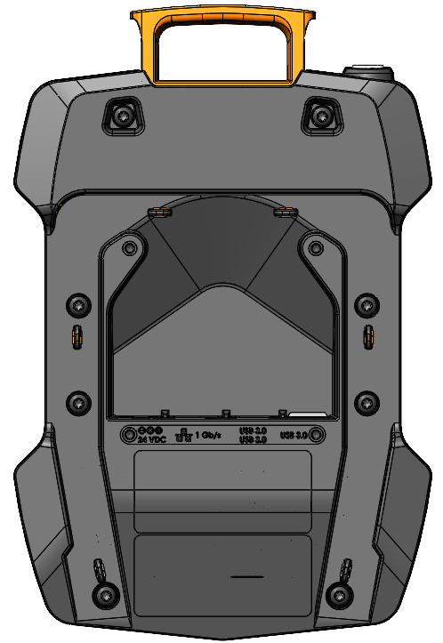
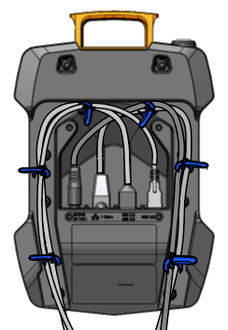
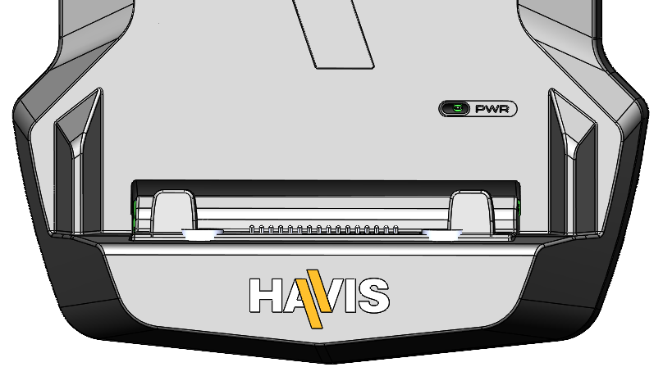
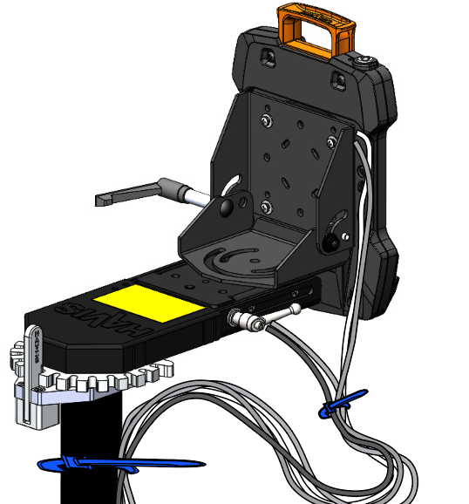
Cable Management (DS-TAB-401)
Tip the Docking Station to a position that is comfortable to work with.
Install all cables that are necessary for computing needs.
Use Zip Ties (Hardware Kit Item 1) and the Strain Relief Points to secure cables and reduce risk of accidental disconnects.
Create a service loop with cables to ensure that no tension is on the connectors and to enable intended motion.
Tie off cables onto a stationary part of the mounting system.
After connecting
to vehicle power. This green
LED will illuminate indicating
that the dock has power
4
This loop must be large enough to allow full range of expected rotation and extension without stressing connections.
5
Collect cables to secure to the mounting system or vehicle.
(Note: mounting system not included)

Slide 8
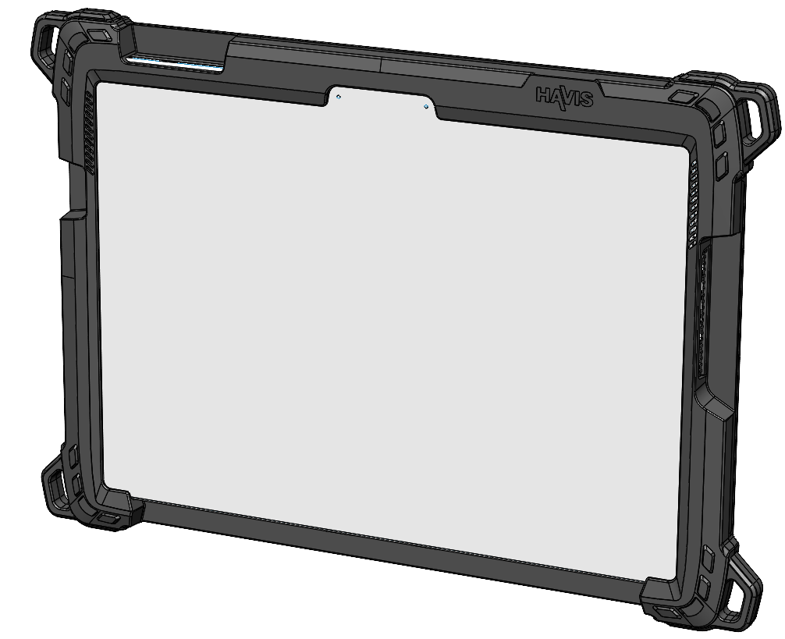
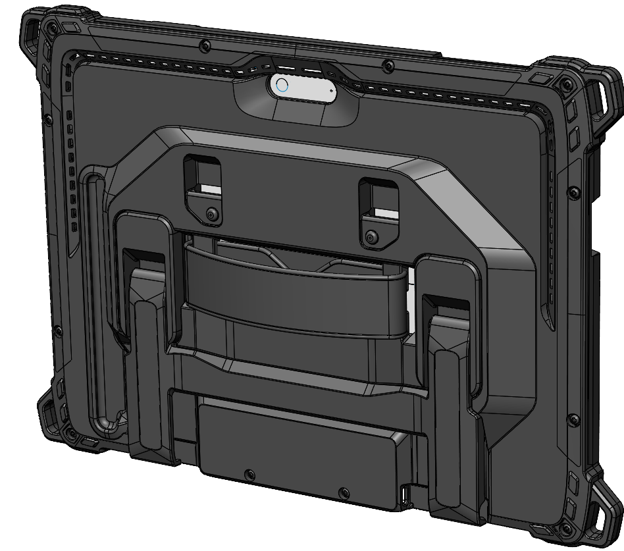
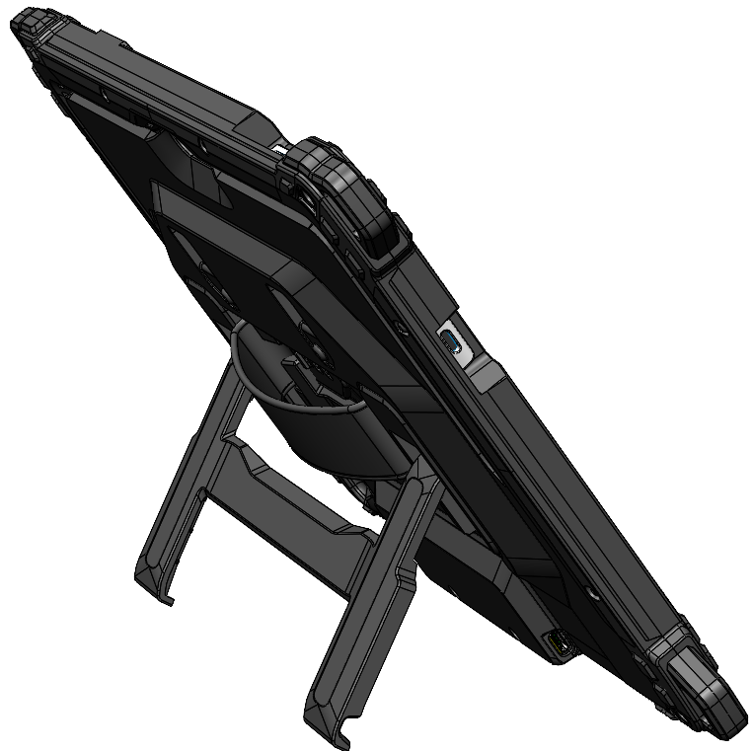
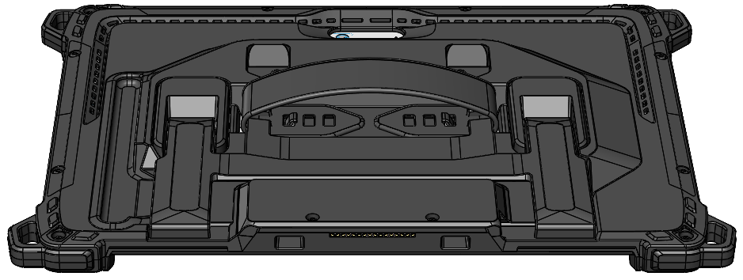
Parts Included (TC-401)
Tablet Case (Part ID TC-401 shown assembled with Microsoft Surface Pro 9/10/11th)
Power and Volume Controls
USB Type C Port Access
Desk Dock Port Access
Keyboard Access Opening
Shoulder Strap Clip
Mounting Points
Kick Stand
Docking Latch Pockets
Hand Strap
(shown assembled)
shown in extended position
Stylus Holder
(Compatible with Microsoft magnetic Stylus ONLY)
Docking Connector
Docking Alignment Pockets

Slide 9
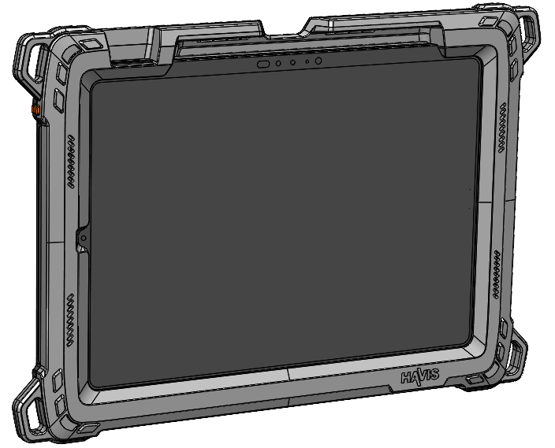
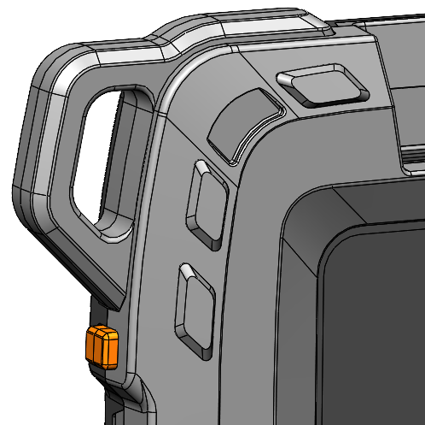
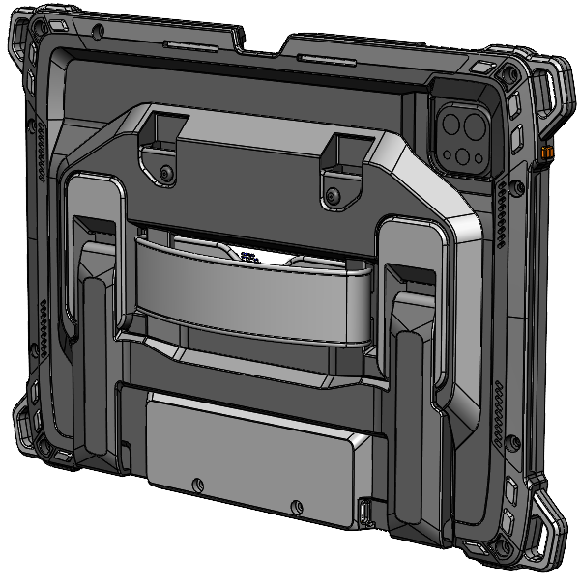
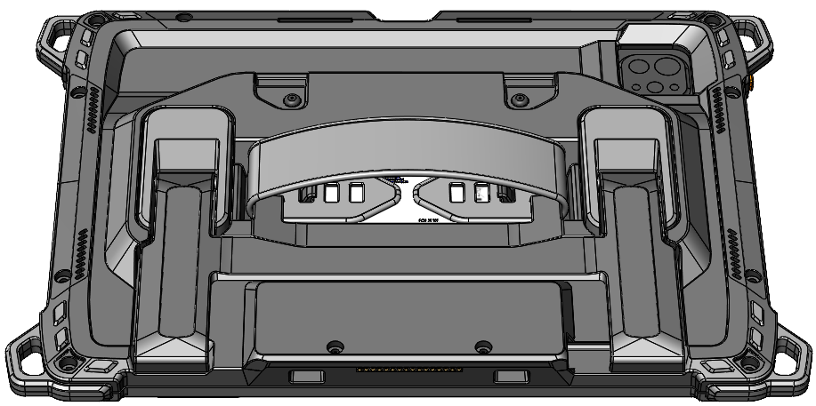
Parts Included (TC-402,403, 404, 405, 406 and 409)
Tablet Case (Part ID TC-403 shown assembled with iPad Pro M4)
Power and Volume Controls
Apple Pencil Storage
Power Button
Shoulder Strap Clip
Mounting Points
Kick Stand
Docking Latch Pockets
Hand Strap
(shown assembled)
shown in extended position
Docking Connector
Docking Alignment Pockets

Slide 10
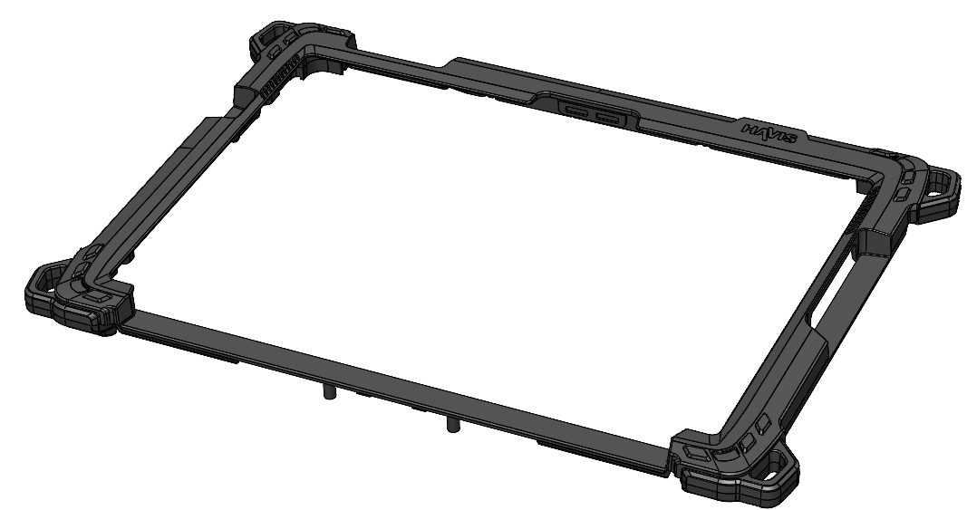
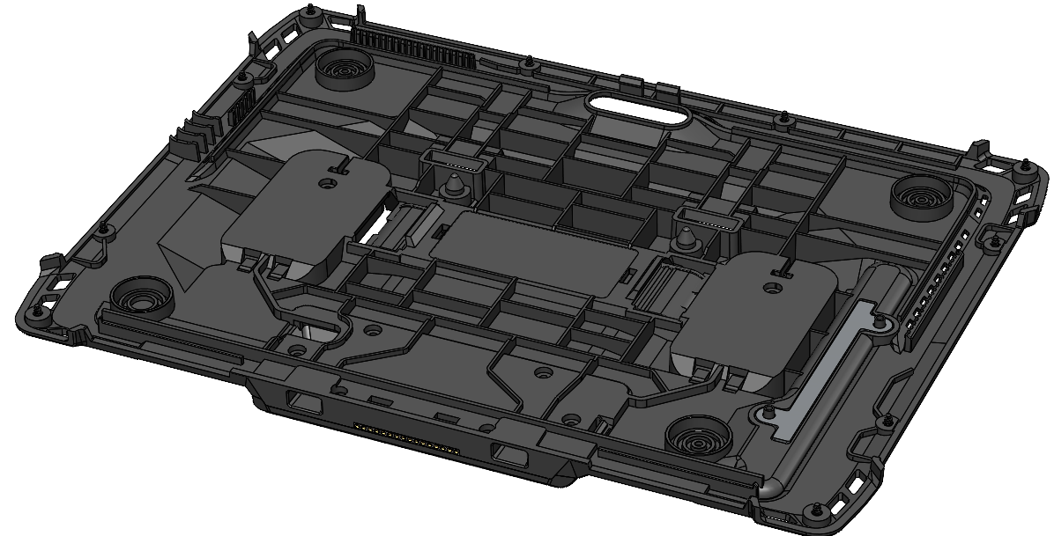
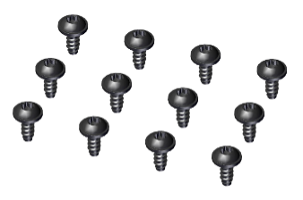

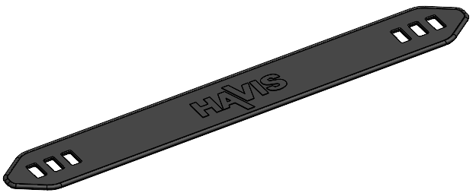
Parts Included (TC-4XX)
Tablet Case
Front Tablet Case
Back Tablet Case Assembly
Hardware Kit (HWK-0055)
This Hardware Kit includes:
1. M2.5 , 6mm long Washer Head Screws (12)
2. T8 Torx Bit, ¼” Hex Shank (1)
Tools required for installation:
• ¼” Driver for T8 Torx Bit
(For attaching Back Piece to Front Piece
with M2.5 Washer Head Screws)
j
k
Additional Items:
Depending on Tablet Case Model, Tablet Case may include:
1. Hand Strap (Qty:1)
k

Slide 11
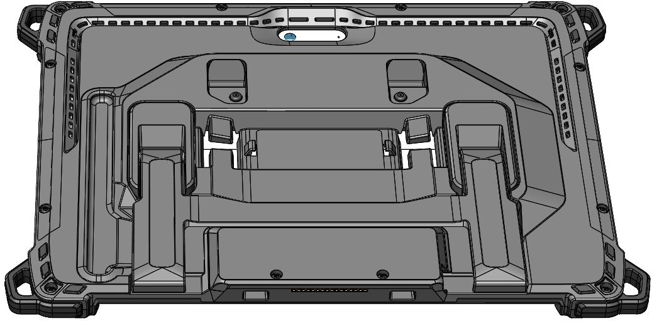
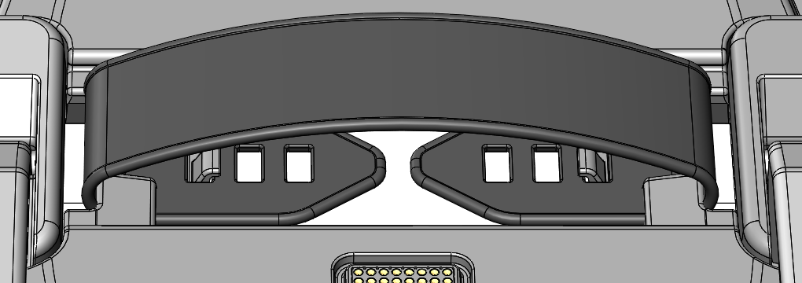
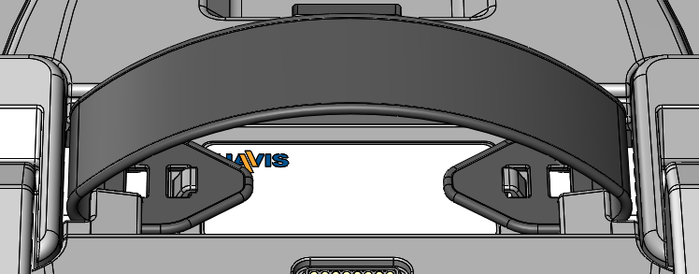
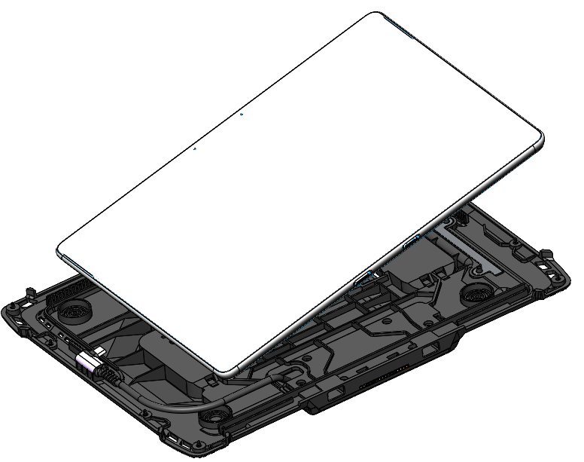
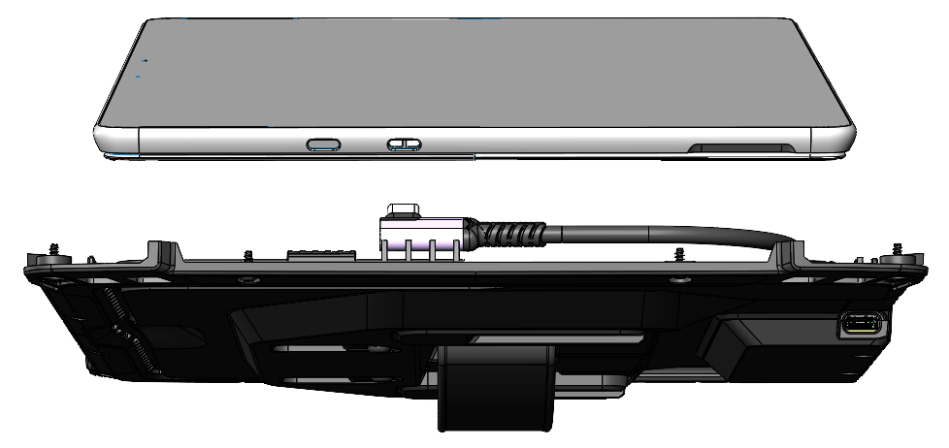
Installation (TC-4XX)
IF A SCREEN PROTECTOR IS BEING USED ON TABLET (NOT INCLUDED),
ASSEMBLE BEFORE BEGINNING TABLET CASE INSTALLATION.
Assemble hand strap by guiding each end through the slots on the Back Assembly of Tablet Case. Adjust loop size as desired and secure on the hook featured of the rear housing.
With the front cover removed. Insert the USB connector from the Back Assembly of the Tablet Case into the circled USB port of the tablet (TC-401 shown as example).
Smallest hand strap setting
Largest hand strap setting

Slide 12
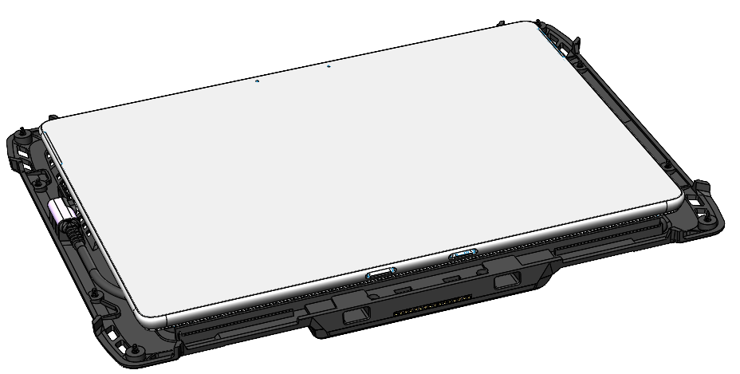
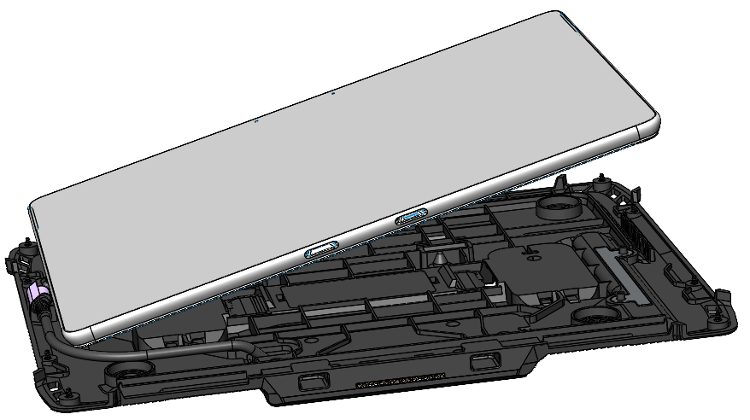
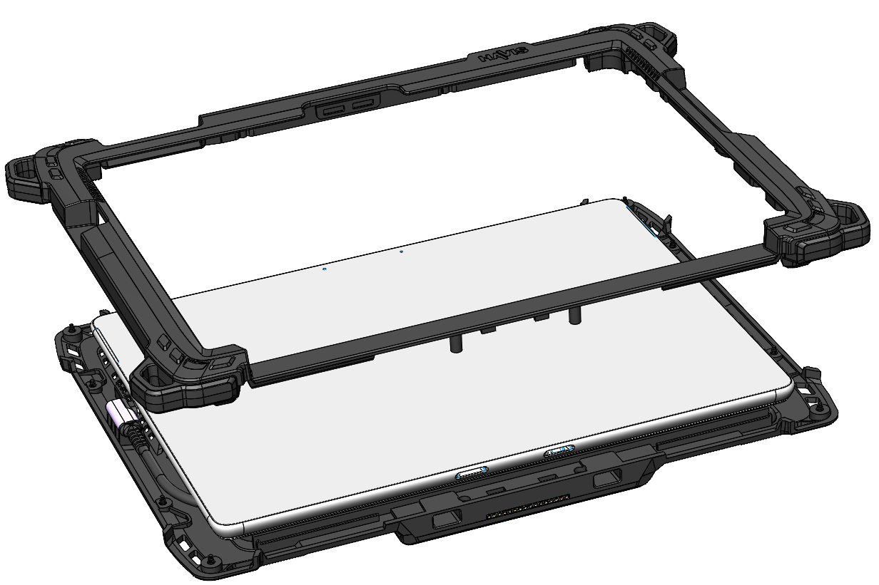
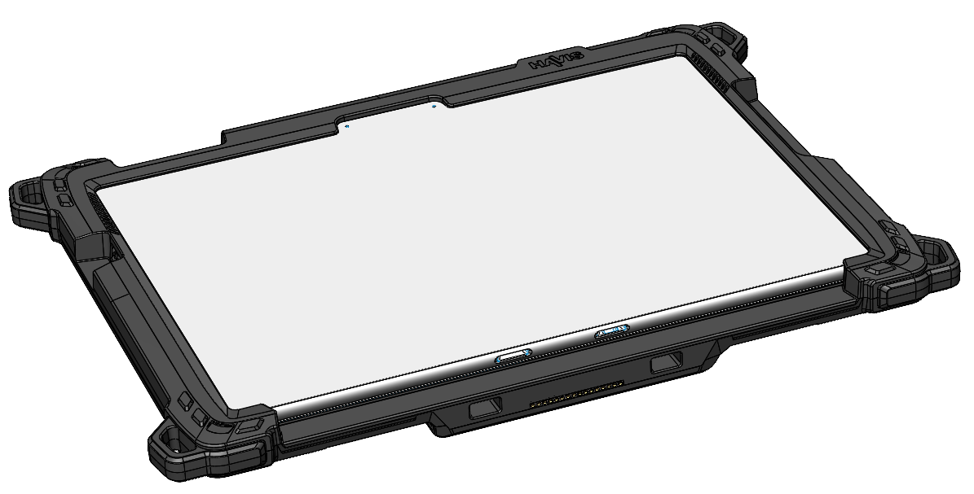
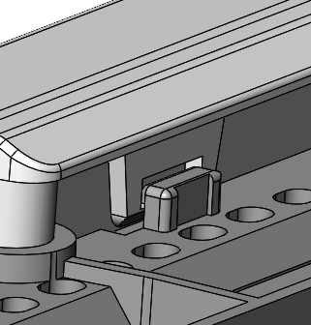
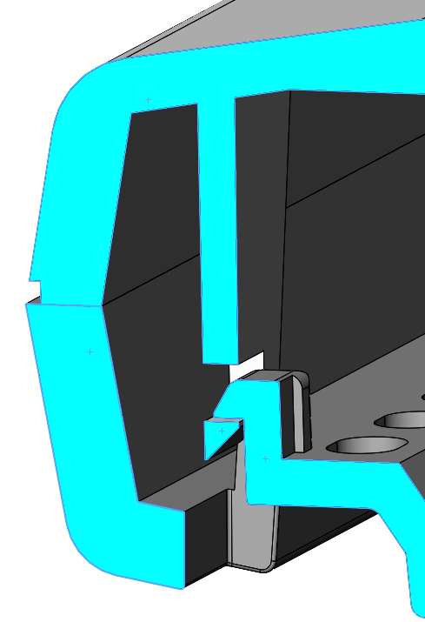
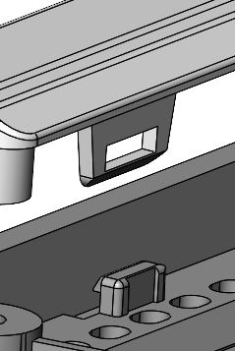
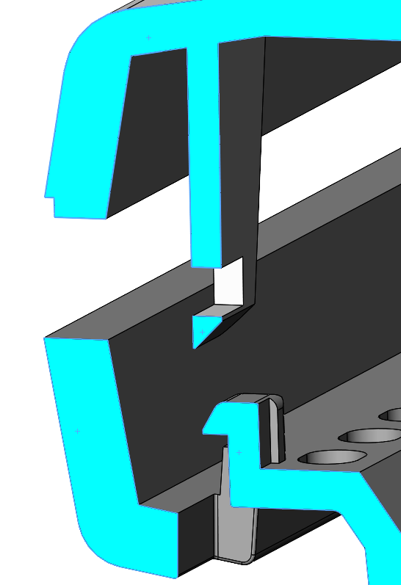
Installation (TC-401 shown as example)
3) Lower the Tablet into the rear housing. Ensuring that the connector cable is routed properly, being careful not to pinch cable.
4) Place the Front Assembly of the Tablet Case on the Back Assembly. Ensure a proper fit by looking for gaps along the seam between the two pieces. This case contains six snap fits denoted with the arrows below. Apply light pressure around the entire perimeter to ensure that all six snaps engage.
Cross section view of Front case
snapping into the Back case.

Slide 13
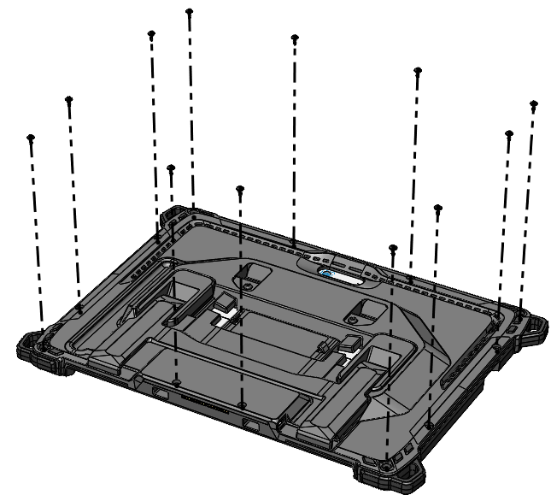
Installation (TC-401 shown as example)
5)
Holding the two Assemblies together, carefully turn the Tablet Case over. Insert all the necessary screws (Hardware Kit Item 1) and tighten with provided T8 Torx Bit (Hardware Kit Item 5). Torque screws to 4 in-lbs (0.45Nm) ± 10%.
CAUTION: DO NOT OVERTIGHTEN SCREWS OR DAMAGE TO TABLET CASE MAY OCCUR.
6)
To remove your tablet from the Tablet Case remove all the screws then carefully turn the case over. If your Tablet Case includes interlocking snaps use your fingers to pry the Front Assembly up from the inside edge along the screen. Lift the Front Assembly off the Back Assembly, unplug the connector, and remove tablet.

Slide 14
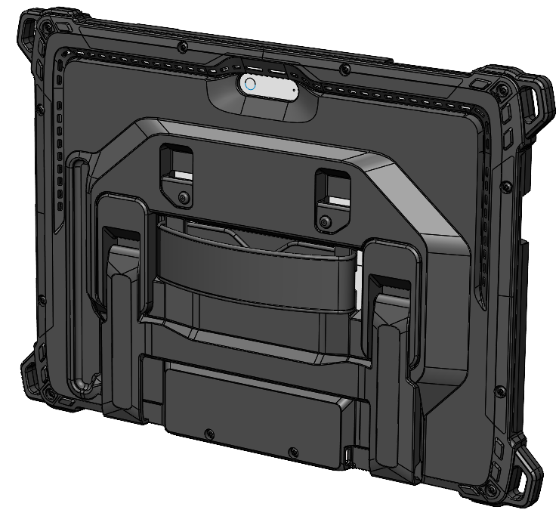
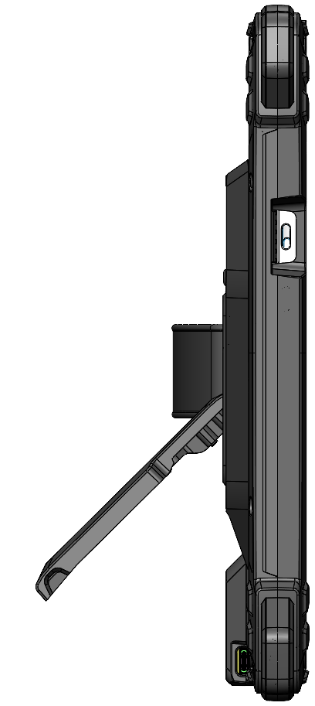
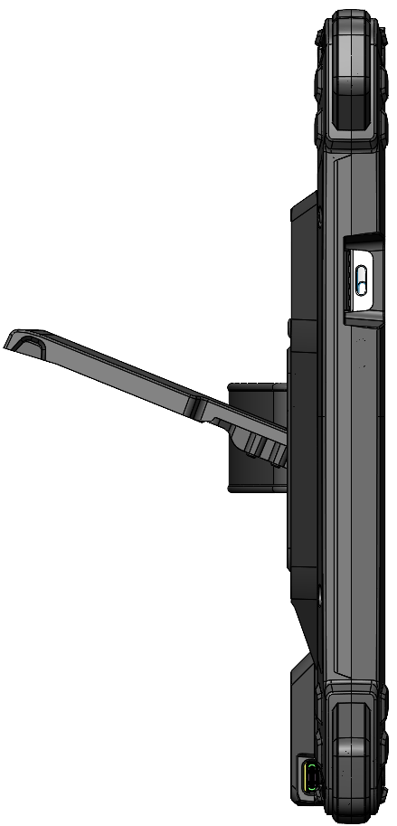
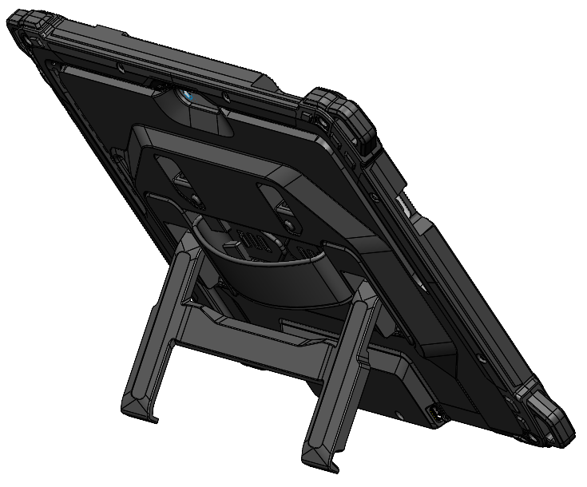
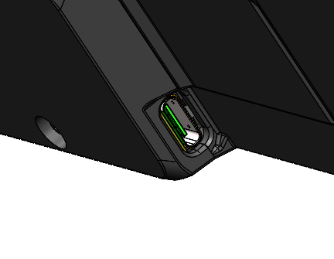
Tablet Case Features (TC-4XX)
The Kickstand on this tablet case can hold the tablet through a wide range in the landscape orientation.
With the kick stand moved access is open to a USB C Port that connects to your tablet.
Wide range of angles available in landscape orientation

Slide 15

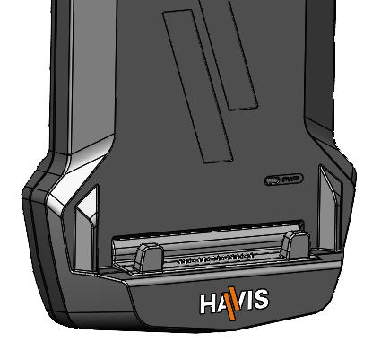
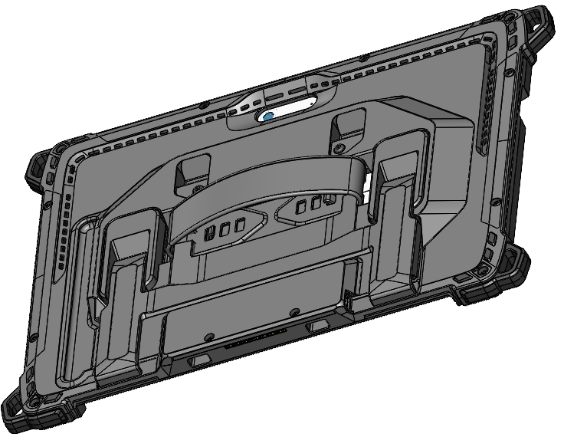
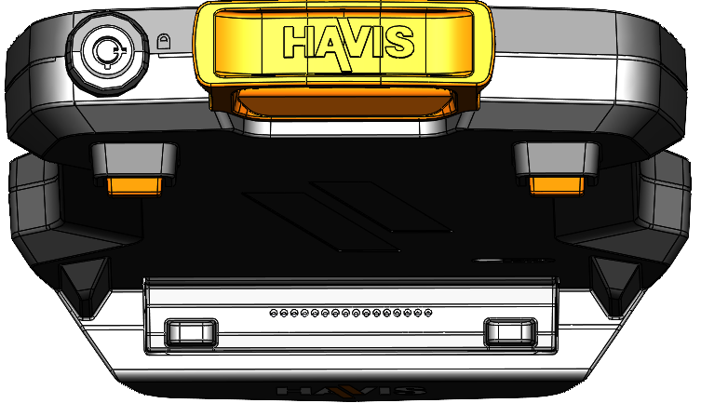

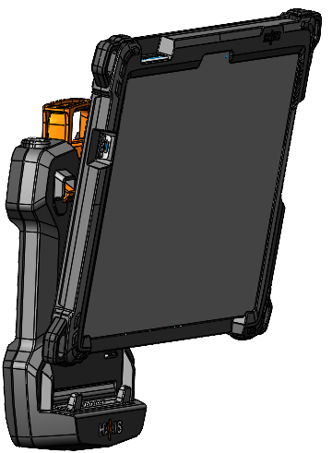
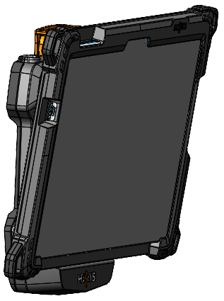

Operation - Docking
DO NOT FORCE TABLET CASE INTO DOCKING STATION. IF THERE IS RESISTANCE,
CHECK ALIGNMENT OF TABLET CASE ON DOCKING STATION.
NOTE: Ensure a proper connection by aligning the Tablet Case’s
Alignment Pockets with the Docking Station’s Front Hooks
Front Hooks on the
DS-TAB-200 Series Docking Station
Alignment Pockets on the bottom piece
of the TC-4XX Series Tablet Case
Ensure the Docking Station is unlocked.
Hold Tablet in landscape orientation, with bottom angled toward Docking Station. Lower Tablet onto the Docking Station so the Alignment Pockets on the Tablet Case align with the Front Hooks on the Docking Station.

Slide 16



Operation – Docking (continued)
Pivot Tablet Case into the Docking Station until the Docking Station’s Latch Hook engages with the Latch Hook Recess on the Tablet Case. A click will be heard when docked correctly.
For theft deterrence, secure Tablet Case by locking Docking Station with supplied key (Hardware Kit Item 2).

Slide 17


Operation - Undocking
If previously locked, unlock Docking Station using the supplied key.
While holding Tablet Case with one hand, lift the Release Handle on the top of Docking Station.
While lifting the Release Handle grab the side of Tablet Case, rock the top forward and carefully lift out of Docking Station, top end first.

Slide 18
Regulatory Information
Canada
CAN ICES-3 (B) / NMB-3 (B)
Class B equipment
This Class B digital apparatus meets all requirements of the Canadian Interference-Causing Equipment Regulations.
Équipement de classe B
Cet appareil numérique de la classe B respecte toutes les exigences du Règlement sur le matériel brouilleur du Canada.
United States of America
FCC Compliance
This device complies with part 15 of the FCC Rules. Operation is subject to the following two conditions: (1) This device may not cause harmful interference, and (2) this device must accept any interference received, including interference that may cause undesired operation.
Note: This equipment has been tested and found to comply with the limits for a Class B digital device, pursuant to part 15 of the FCC Rules. These limits are designed to provide reasonable protection against harmful interference in a residential installation. This equipment generates, uses and can radiate radio frequency energy and, if not installed and used in accordance with the instructions, may cause harmful interference to radio communications. However, there is no guarantee that interference will not occur in a particular installation. If this equipment does cause harmful interference to radio or television reception, which can be determined by turning the equipment off and on, the user is encouraged to try to correct the interference by one or more of the following measures:
Reorient or relocate the receiving antenna.
Increase the separation between the equipment and receiver.
Connect the equipment into an outlet on a circuit different from that to which the receiver is connected.
Consult the dealer or an experienced radio/TV technician for help.
Changes or modifications not expressly approved by the party responsible for compliance could void the user's authority to operate the equipment.
Responsible party (contact for FCC matters only):
Havis, Inc.
75 Jacksonville Road
Warminster, PA 18974
havis.com/contact-us

Slide 19


Regulatory Information (continued)
European Union
Waste Electrical and Electronic Equipment (WEEE)
Electrical and electronic equipment (EEE) contain materials, components and substances that can be hazardous and harmful to human health and the environment when WEEE is not disposed of properly.
Products marked with the "crossed-out wheeled bin" symbol are EEE. The crossed-out wheeled bin symbolizes that WEEE must not be disposed of together with unsorted household waste, but must be collected separately.
For this purpose, all municipalities have established collection schemes where WEEE can be handed in, free of charge, by citizens at recycling stations or other collection points or collected directly from households. Further information should be obtained from the municipality's technical administration.
This symbol on the product or on its packaging indicates that the product must not be disposed of with normal household waste. Instead, it is your responsibility to dispose of your waste equipment by arranging to return it to a designated collection point for the recycling of WEEE. By separating and recycling your waste equipment at the time of disposal, you will help to conserve natural resources and ensure that the equipment is recycled in a manner that protects human health and the environment. This product is EEE and shall not be placed in the municipal waste after end of its life. This device should be handled properly and handed over to appropriate collection places or to authorized companies.
Conformité Européene (CE) Mark
The CE marking on a Havis product indicates conformity to the provisions of applicable European Union (EU) directives. The EU Declaration of Conformity (DoC) is the manufacturer’s declaration that the product complies with those directives.
EU Authorized Representative:
PWA Electronic Service – und Vertriebs GmbH
Liebigstraße 12, 63500 Seligenstadt, Germany

Slide 20








Related Products
Havis offers a wide variety of accessory products specifically for use with your Docking Station and Protective Case.
For more information or to order, please visit www.havis.com.
C-MD-401/402 and PKG-FAM-118
Universal Rugged Articulating Phone & Tablet Mounts
Light weight mounts are an ideal mobile solution for tablet, phone, or keyboard
DS-DA-218
Desktop Stand for Tablet Docking Stations
Durable stand for mounting tablet Docking Stations for use in the home or office.
DS-DA-117 Tablet Case Shoulder Strap
Mount this Shoulder Strap to the top of the Tablet Case for easy carrying for the Microsoft and Samsung Cases.
DS-DA-502
Replacement Keys
Set of two (2) replacement keys for DS-TAB-400 Series Docking Stations.
LPS-184
DC Power Supply
24 Volt power supply for in vehicle applications
LPS-183
AC Power Supply
24 Volt power supply for in office applications

